Slide 1
Problem Statement and Understanding
One of our clients has website where people write different reviews for technical products. Now they are adding a new feature to their website i.e. The reviewer will have to add stars(rating) as well with the review. The rating is out 5 stars and it only has 5 options available 1 star, 2 stars, 3 stars, 4 stars, 5 stars. Now they want to predict ratings for the reviews which were written in the past and they don’t have a rating. So, we have to build an application which can predict the rating by seeing the review.
There is a database where reviews of technical products are mentioned and we have label called ratings where we need to predict the ratings of the product based on its reviews. But before using reviews to predict the outcome we have collected the data, cleaned the data, transform the data into structured format and run many EDAs to make findings.
Have used total 7 machine learning models to train the data however have chosen MultinomialNB Model since its accuracy of train data and test data is high and close to each other i.e., 67.72% and 63.17% respectively.

Slide 2
EDA Steps
Identifying sources of the data
Data collection
Data structuring
Analysing the data
Cleaning and processing the data
Writing down findings and observations
Using different models to train the data
Selecting best fitted model for predictions
Hyper tuning the selected model
Predicting outcome for test data

Slide 3
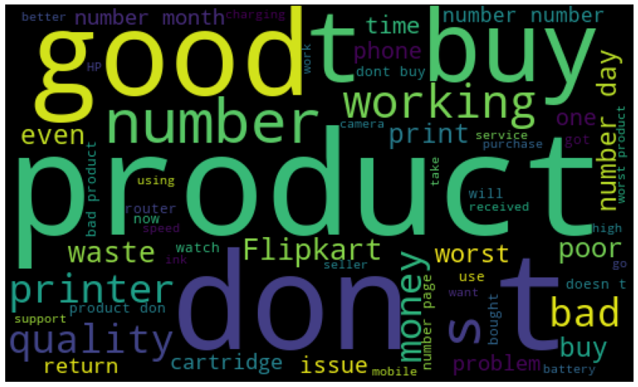
Visualizations
Word Cloud: -
Observations:
Below is the list of highly influencing words to predict Ratings.
1. Buy
2. Don’t
3. Waste
4. Working
5. Quality
6. Issue
7. Money
8. Bad
9. Good
10. Number

Slide 4
Steps and Assumptions
Clean and organized the data.
Checked the data type of each column.
Changed the Float data type to Integer.
Checked whether the data has any Null Values.
Checked whether the data is categorical data or continuous data.
There are many categorical columns which has same output with different variable so used replace function to clean the data.
Checked the Distribution of data.
Processed the data and encoded reviews column to build model.

Slide 5
Model Dashboard
Identification of possible problem
The data was not structured and organized hence cleaned the data using various data cleaning and pre-processing techniques.
Converted a collection of raw documents to a matrix.
Testing of Identified Approaches
These are the algorithms which have been used to train and test data.
RandomForestClassifier
LogisticRegression
GradientBoostingClassifier
DecisionTreeClassifier
KNeighborsClassifier
SVC
MultinomialNB

Slide 6
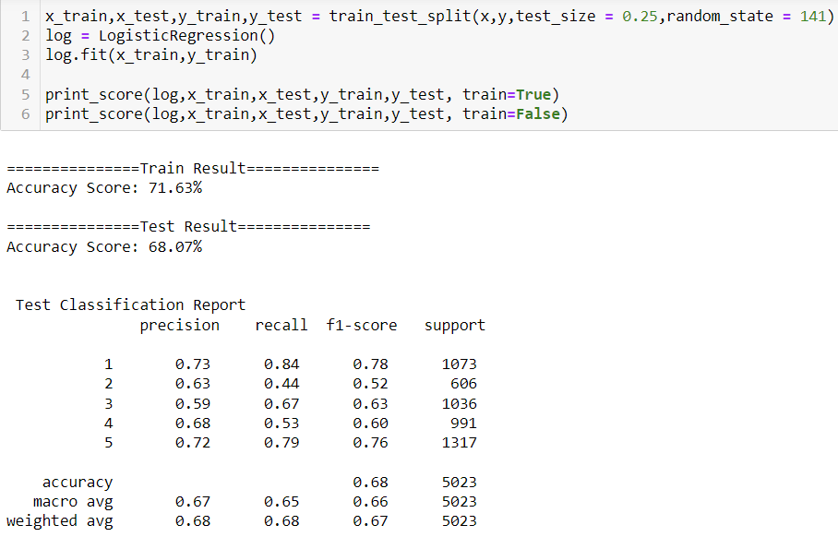
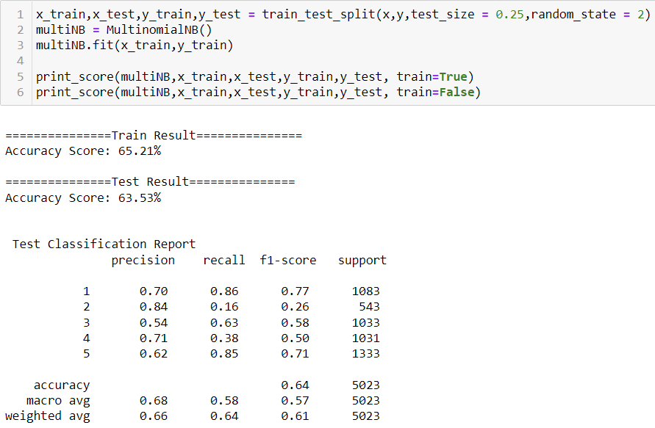
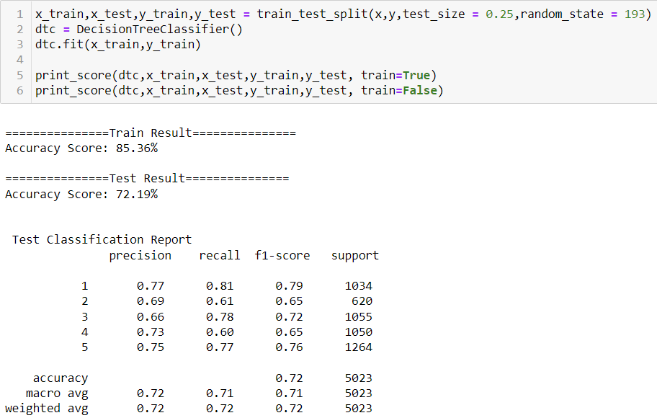
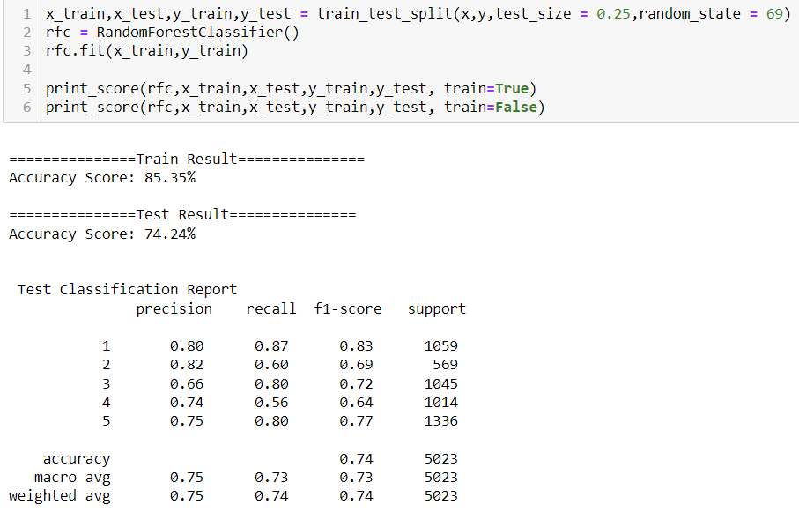
Model Dashboard
1. LogisticRegression: -
2. DecisionTreeClassifier: -
3. MultinomialNB: -
4. RandomForestClassifier: -

Slide 7
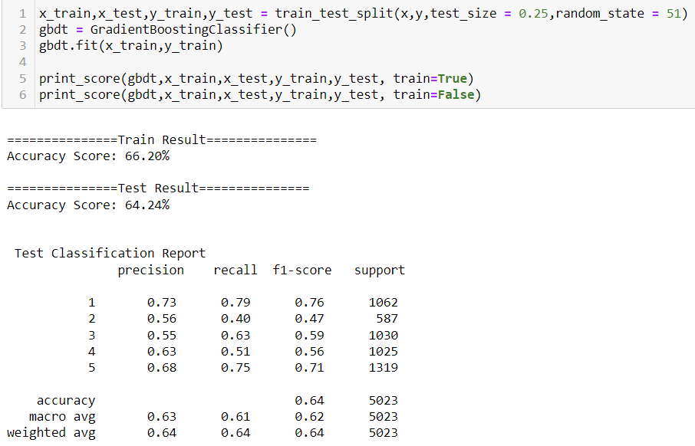
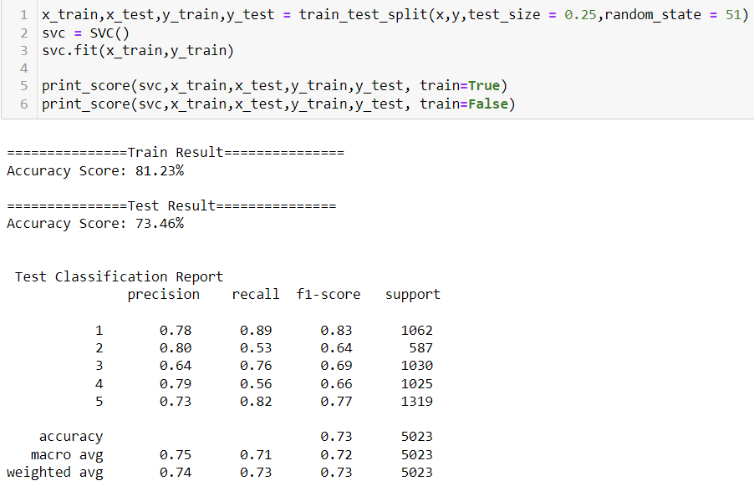
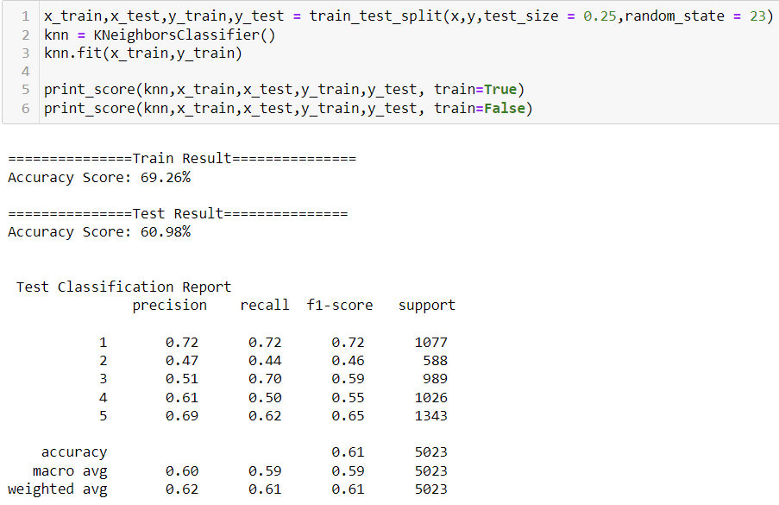
Model Dashboard
5. GradientBoostingClassifier: -
6. KNeighborsClassifier: -
7. Support Vector Classifier: -

Slide 8
Finalized Model
Key Findings and Conclusions of the Model
1. Selecting MultinomialNB model since the Accuracy score i.e., 67.72 % and test scores i.e., 63.17 % are greater and close to each other.
2. Precision and recall is 63%.
3. Result after Hyper Parameter Tuning
Previous Test Accuracy Score 63.53% and New Test Accuracy score 63.17%
Previous Train Accuracy Score 65.21% and New Train Accuracy score 67.72%

Slide 9
Conclusion
Learning Outcomes of the Study in respect of Data Science
1. Data Cleaning helps to convert unorganized and unstructured data into structured data which will be used to make findings.
2. Data visualization helps understand and analyse the data.
3. Model building helps to predict outcomes, in this case MultinomialNB model fits perfect for this dataset.

